Slide 1

Adobe Analytics Challenge 2021
adobeanalyticschallenge.com

Slide 2

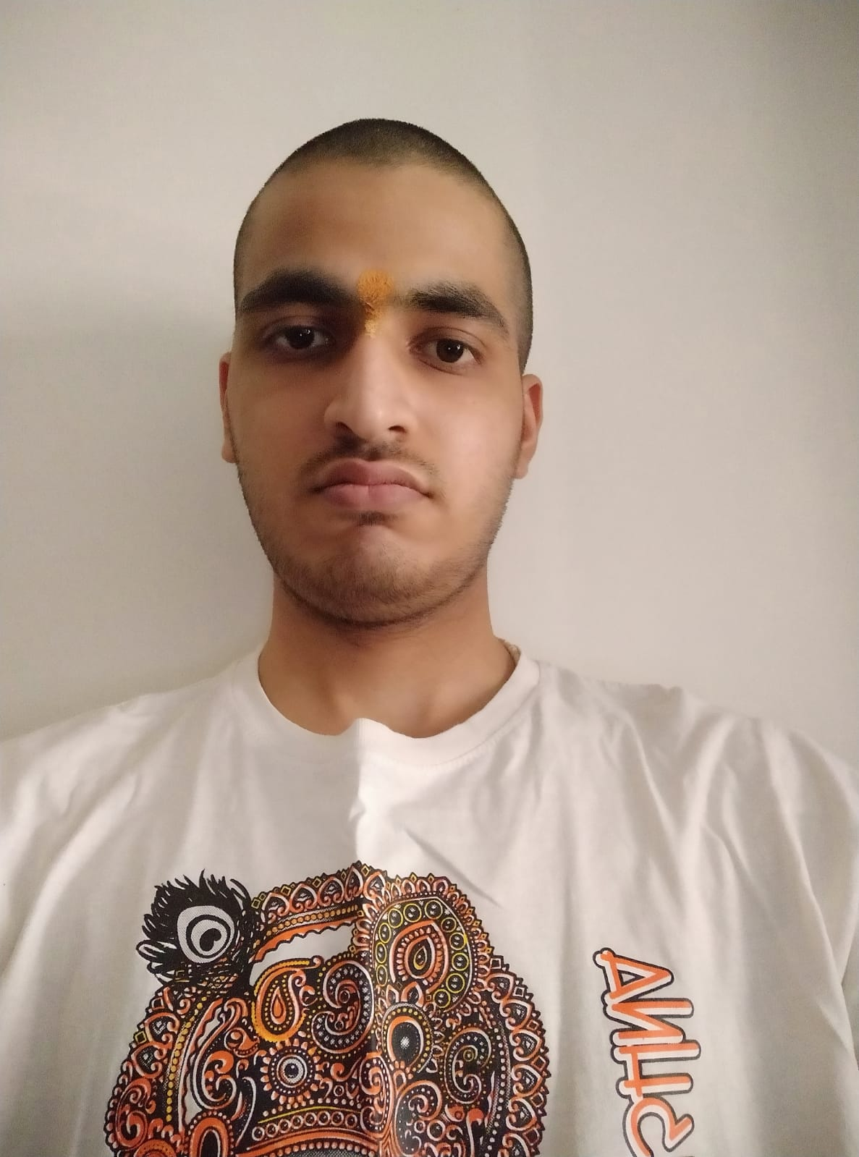
TEAM PROMETHEUS
Jagannath Patta
https://www.linkedin.com/in/jagannath-patta/
( FY M.C.A )
Bharatiya Vidya Bhavan's Sardar Patel Institute of Technology (SPIT)
Udit Kulkarni
https://www.linkedin.com/in/udit-kulkarni-2baa71216/
( FY M.C.A )
Bharatiya Vidya Bhavan's Sardar Patel Institute of Technology (SPIT)

Slide 3
AGENDA
1
Observations
2
Inferences and conclusions if any
3
Advice to Disney

Slide 4

For those whose first purchase is during the period, what behaviours are most indicative of a subsequent(or multiple subsequent) purchases?
How do we encourage this?
Note: -
1)Analysed data for Question (1) is for Disney Web, and time period is Oct 1,2020 - Sep 30, 2021
2)Inference, conclusions and Advice to Disney would be given at end of all the observations

Slide 5
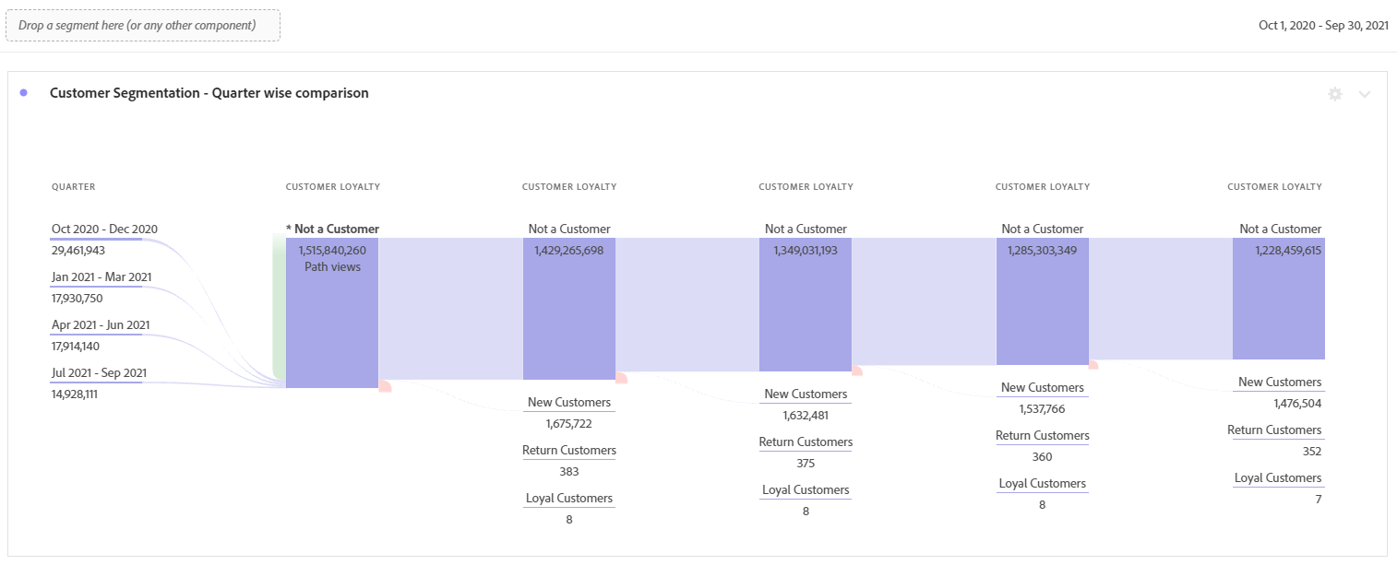
Fig 1.1
As Disney’s business is seasonal we first analyse the inflow of the potential customers by breaking the year in quarters.
For those whose first purchase is during the period we find that :-
Observation (1.1) : -
Highest inflow of potential customers(i.e. Not a customer) are during the period Oct,2020 - Dec 2020
Lowest inflow of potential customers(i.e. Not a customer) are during the period July,2021 - Sep,2021

Slide 6
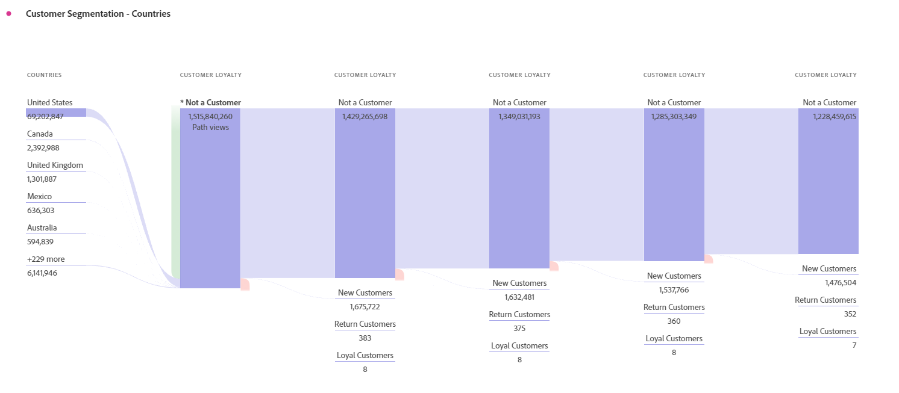
Fig 1.2
Disney’s business is global so we analyse the inflow of potential customers from different countries.
For those whose first purchase is during the period we find that :-
Observation (1.2) : -
United States, Canada, United Kingdom are top 3 countries which have the higher inflow of potential customers(i.e. Not a customer) in terms of highest to lowest respectively.
On further analysis we find that California, Florida, Texas, New York, Illinois are the top 5 regions in United States having higher inflow of potential customers (i.e. Not a customer) in terms of highest to lowest respectively.

Slide 7
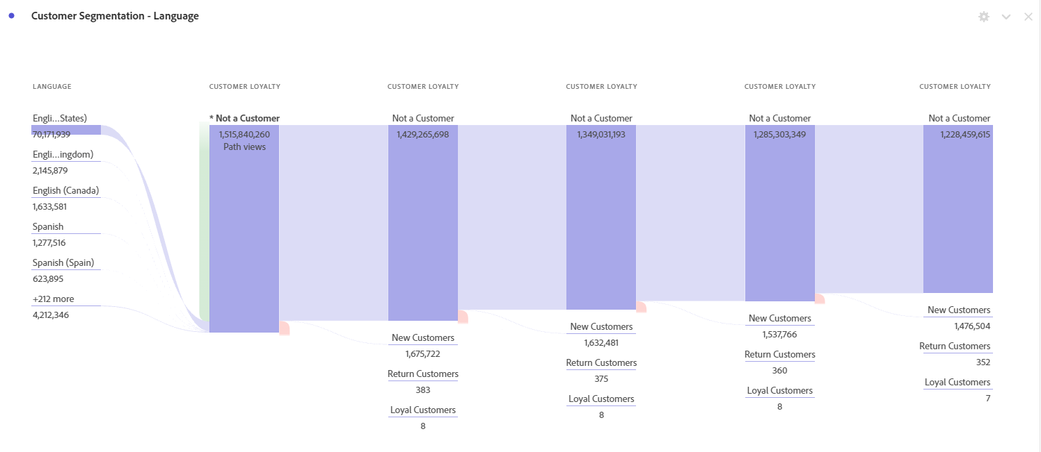
Fig 1.3
Now we analyse which languages do potential customers prefer to see the content in
For those whose first purchase is during the period we find that :-
Observation (1.3) : -
It is not surprising to see that the top 3 languages that potential customers prefer to see the content in is English. However Spanish is the top 4th language that the potential customers are interested to see the content in.

Slide 8
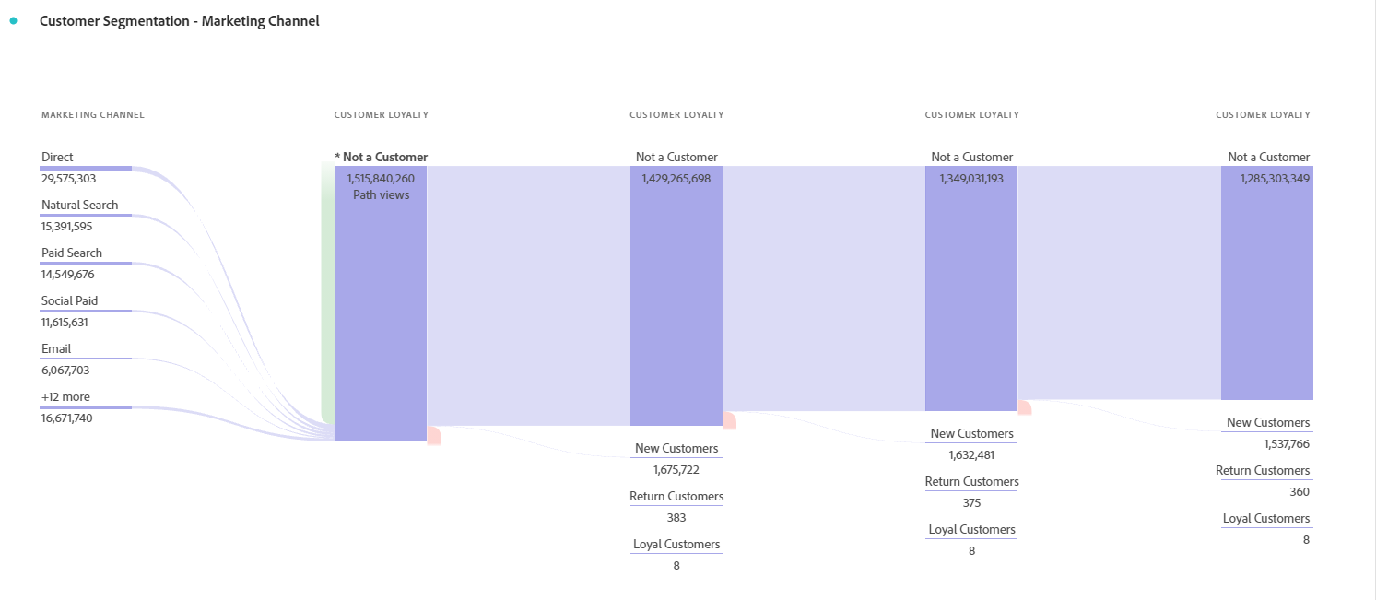
Fig 1.4
Now we analyse from which marketing channels do the potential customers enter the Disney’s website.
For those whose first purchase is during the period we find that :-
Observation (1.4) : -
The top 3 marketing channels are Direct, Natural Search and Paid Search

Slide 9
Some Inferences and Conclusions
Let's define a formula for conversion rate of potential customers to customers: -
Conversion rate of potential customers to customers =
{[(𝚺 New Customers) + (𝚺 Return Customers) + (𝚺 Loyal Customers)] of node (i+1) / (𝚺 Not a Customer) of node i } *100
According to this formula we observe that the mean of the conversation rate for all the nodes is 0.113 and the standard deviation for the same is 0.0019.
The low standard deviation throws light upon the fact that Disney is consistent in retaining its customers once they buy any product for the first time from its website.

Slide 10
Between July and Sept Disney does not seem to make much business.Disney should try to promote accessories and toys during July and Sept as these products seem to generate highest revenue in both 2020 and 2021 which is enough evidence to conclude the same. These could include paid marketing channels such as youtube ads on channels which are most accessed by kids and advertising their accessories on channels which are accessed by people who buy accessories.(Paid Searches are the third highest category of Marketing channels from where the inflow of potential customers[Observation 1.4])
Focussing more on the regions mentioned in observation 1.2 would help Disney increase their revenue and leverage the inflowing of first-time purchasers. Paid Search can be used to increase the customer inflow in this aspect.
An interesting observation (1.3 (a)) is that customers preferring to see the content in Spanish are third highest among all languages. English maintains the top position in terms of language preferences. Content to the liking of Spanish diaspora, their cultures and traditions must be taking into consideration. This could be a game changer for Disney and it could mean more first time purchasers turning into new customers and subsequent purchasers!
Advice to Disney

Slide 11
Looking at our cart, how do we drive average order value up?
Is that answer different from mobile Vs. Desktop
Note: -
1)Analysed data for Question (1) is for Disney Web, and time period is Oct 1,2020 - Sep 30, 2021
2)Inference, conclusions and Advice to Disney would be given at end of all the observations

Slide 12
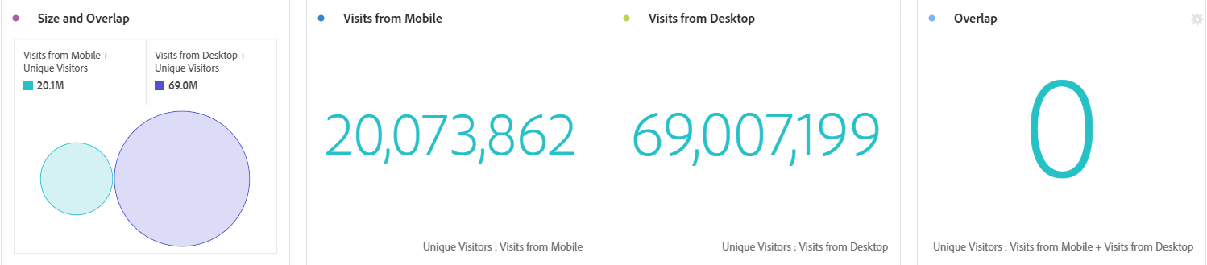
Fig 2.1
Observation (2.1) : -
Above data reflects that Visits from Desktop > Visits from Mobile. Also it is pertinent to note that there is no Overlap between the visits. These visits are exclusive to mobile and Desktop. (Visits from Desktop is created segment which is defined as (Mobile device equals other))
Notes:
Visits from Desktop [Non curated VRS component] is defined as (Mobile device equals other)

Slide 13
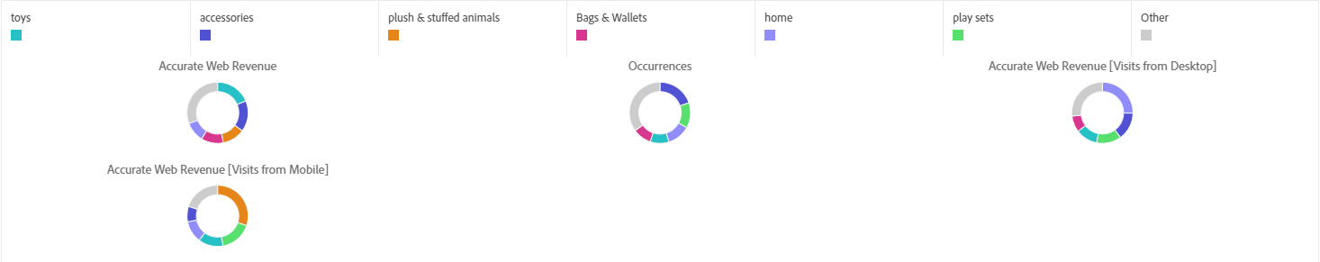
Fig 2.2
Here we analyse the Web Revenue across different categories.
Observation (2.2) : -
Toys, accessories, plush and stuffed animals are top three categories which contribute maximum to the web revenue.
Visits from Mobile have greater contribution to the revenue than Visits from desktop(in terms of top 3 categories)
However the revenue from desktop visits is greater than revenue from mobile visits.

Slide 14
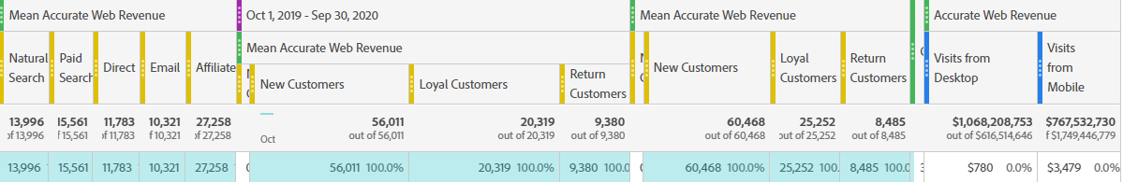
Fig 2.3
Here we analyse the Average web revenue across Marketing channels and customer loyalty. We also compare the data for two years.(Oct 1,2019 - Sep 30,2020) and (Oct 1, 2020 - Sep 30,2021)
Observation (2.3) : -
Average web revenue from Affiliate marketing is highest while Paid search takes the second place.
Second time purchasers contribute more to the revenue in both the time periods.
Revenue from Desktop is higher than Revenue from Mobile.

Slide 15
The Visits from Desktop are higher than Visits from Mobile (Observation 2.1) but the revenue from Desktop is 28% higher than the revenue from Mobile. This could be due to various reasons. It seems as if people “window-shop” when they are visiting from mobile. Disney could concentrate its efforts on making the user experience from mobile easier in terms of checkouts and payments. This will increase the conversion rate from mobile visits and increase the average order value.
Toys, accessories, plush and stuffed animals(Observation(2.2 a) ) could be promoted more through Affiliate marketing (Popular youtube channels, instagram stars, social media celebrities can be collaborated with)(Observation(2.3 a) ) or Paid Search (ads) (Observation(2.3 b) ) to further increase the revenue and drive the average order value up!
Bags and Wallets, home category and play sets could be promoted through Paid Search(ads) on relevant youtube channels via Paid Search.
Advice to Disney

Slide 16
What key differences exist between a purchase flow on mobile vs. desktop, and how should we treat those platforms differently / the same?
Note: -
Analysed data for Question (3) is for Disney Web as well as Disney App, and the crucial time period is 3 Quarters of year 2020 from Apr 2020 - Dec 2020
Inference, conclusions and Advice to Disney would be given at end of all the observations

Slide 17
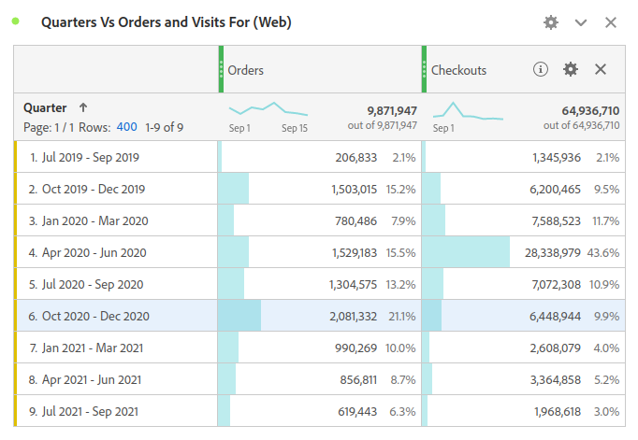
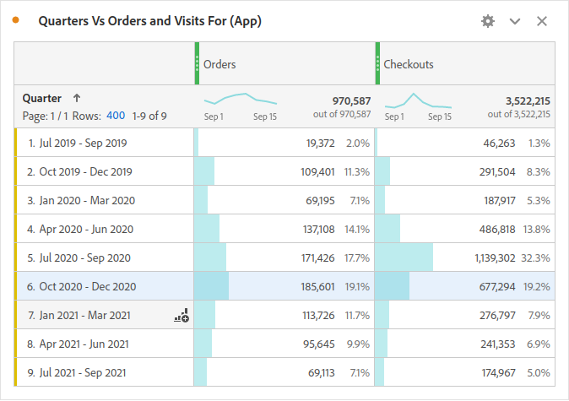
Observation (3.1) :- Here we first come to know that the Orders are not always correlated to the no. of Checkouts.
We can notice that in the Quarter 4 (Apr 2020 - Jun 2020) the no. of checkouts made were the most, but the Orders placed in this period were not highest.
Similarly for the Quarter 6 (Oct 2020 - Dec 2020) the results were opposite i.e even though the checkouts made were not among top 3 high checkouts quarters yet the Orders placed in this period were highest.
Fig : 3.2 (App) Orders and Checkouts in this Period of 2 yrs.
Fig : 3.1 (Web) Orders and Checkouts in this Period of 2 yrs.
Observation (3.2) :- After the observation 3.1 which was on the basis of Disney Web we move check if the similar or different trend is there for Disney App.
We can notice that in the Quarter 5 (Jul 2020 - Sep 2020) the no. of checkouts made were the most, but the Orders places in this period were not highest.
Similarly for the Quarter 6 (Oct 2020 - Dec 2020) the results were different i.e even though the checkouts made were not highest in that quarter yet the Orders placed in this period was highest.

Slide 18
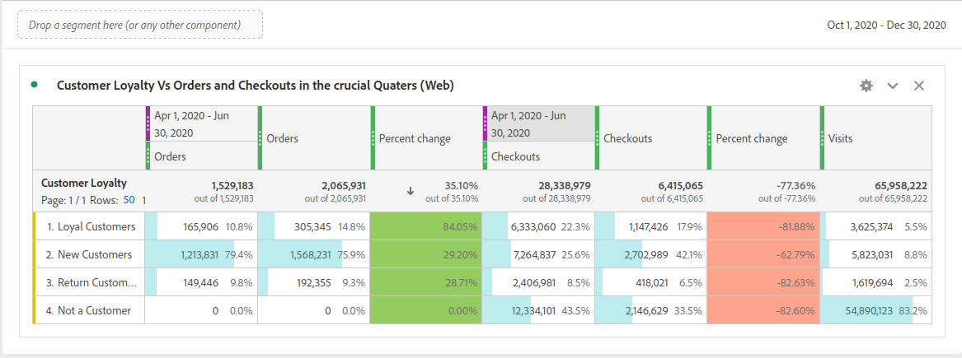
Fig : 3.3 (Web) Orders + Checkouts vs Customer Loyalty over the period of two quarters (Apr 2020 - Jun 2020) and (Oct 2020 - Dec 2020).
Observation (3.3) :- Here we can conclude for the observation 3.1.
Why there are more orders during Oct 2020 - Dec 2020 ?, One of the reasons can be that the most of the festivals were in this quarter .i.e (Festival Season). And we can see this from the data; that in this quarter there was a huge spike of 84.05% in no. of orders placed by the “Loyal Customers”
Why Checkouts were more in the Apr 2020 - Jun 2020 , Because there were huge no. checkouts made by the ‘Not a Customer’,‘Return Customer’, as well as ’Loyal Customers’ Category . And this opens an another question “Why these many checkouts were not converted into orders?”

Slide 19
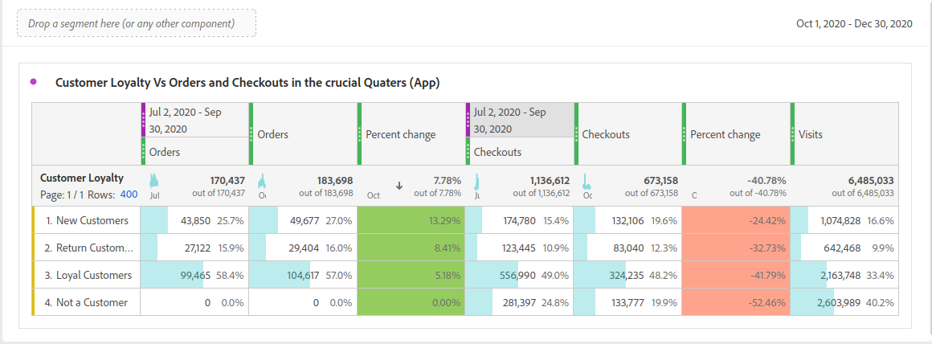
Fig : 3.4 (App) Orders + Checkouts vs Customer Loyalty over the period of two quarters (Jul 2020 - Sep 2020) and (Oct 2020 - Dec 2020).
Observation (3.4) :- Here we can conclude for the observation 3.2.
Why there are more orders in the Oct 2020 - Dec 2020 ?, As we already found that the most of the festivals were in this quarter .i.e (Festival Season). But as we observed in the case of Disney Web here the results were different in the Disney App the trend of increasing orders was started since Apr 2020.
Why Checkouts were more in the Jul 2020 - Sep 2020 but not converted into orders ?, Because there were huge no. checkouts made by the ‘Not a Customer’,‘Return Customer’, as well as ’Loyal Customers’ Category. And then they might realise that in the next quarter (Festival Season) they can avail good discounts and save some money.

Slide 20
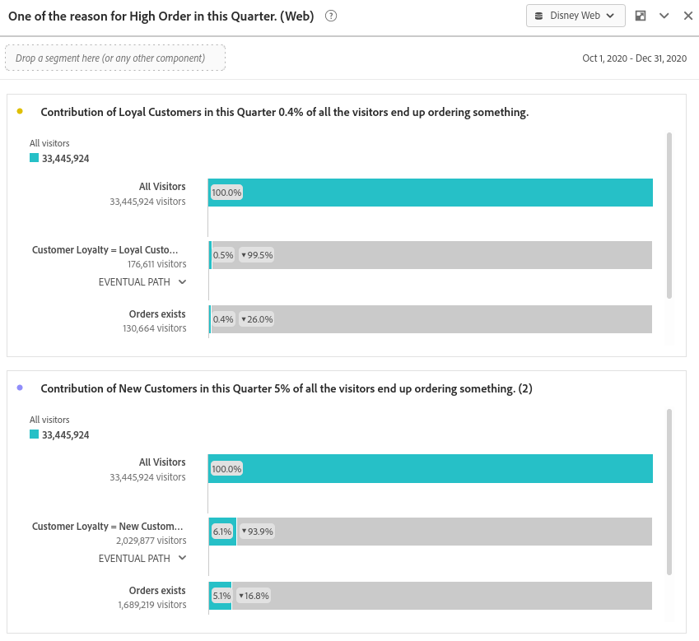
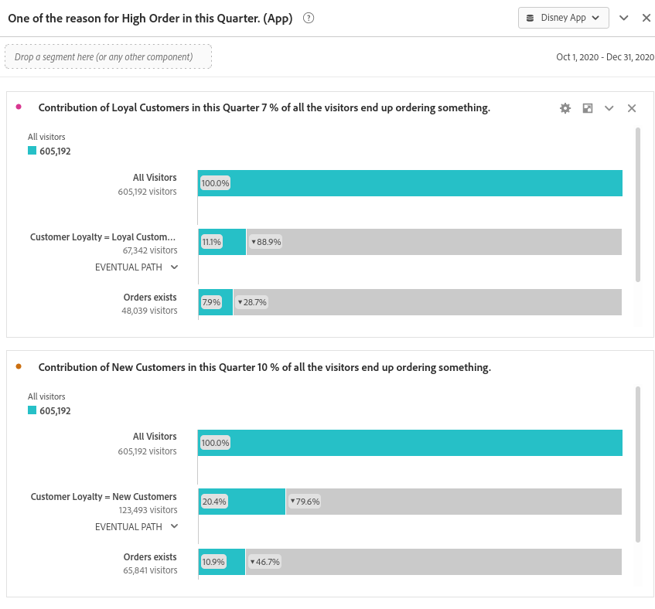
Fig : 3.5 (Web) Customer loyalty fallout to Orders.
Fig : 3.6 (App) Customer loyalty fallout to Orders.
Notes:
Observation (3.5) :- The Web is always the most prioritized option for a New Customer and No. of visits on web is always higher than the App and We should try to get the customers to App.
Observation (3.6) :- On App the conversion rate is high even though the customer visits were low as compared to the Web. We also noticed that in this period of Oct 2020 - Dec 2020 the App installations have also increased.

Slide 21
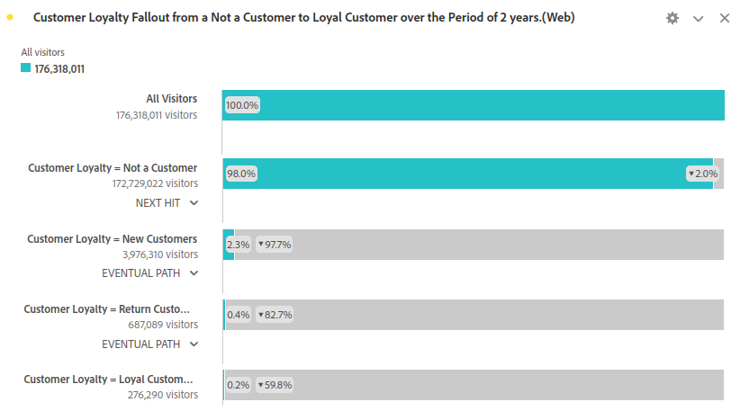
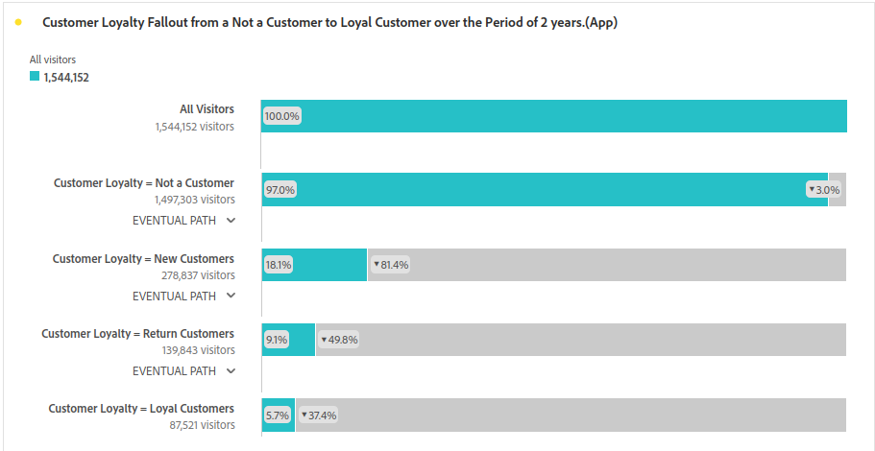
Observation (3.7) :- Disney Web
High Visitors
Low Conversion
Fig : 3.8 (App) Customer loyalty fallout Conversion form Not a Customer to a Loyal Customer over 2 yrs.
Fig : 3.7 (Web) Customer loyalty fallout Conversion form Not a Customer to a Loyal Customer over 2 yrs.
Observation (3.8) :- Disney App
Low Visitors
High Conversion

Slide 22
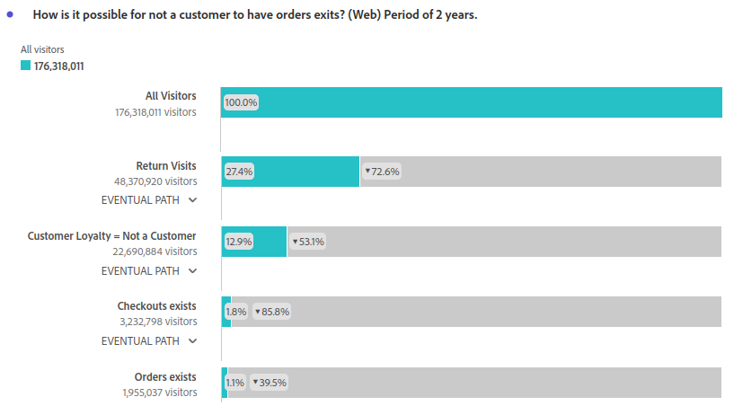
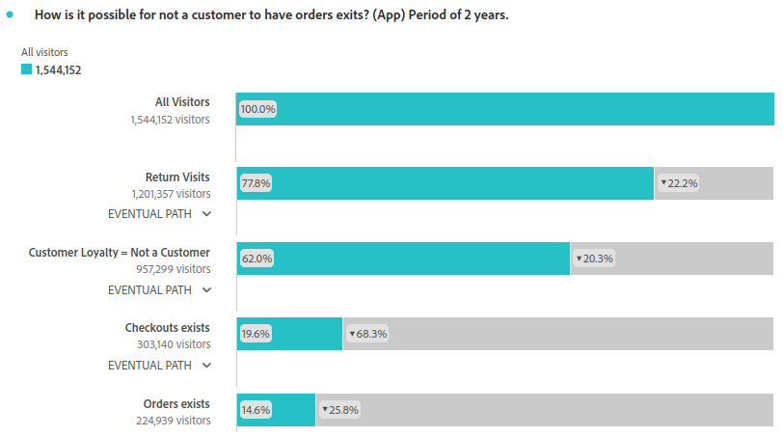

Fig : 3.9 (Web) Fallout Not a Customer to orders over 2 yrs.
Fig : 3.10 (App) Fallout Not a Customer to orders over 2 yrs.
Observation (3.9) :- Based on Both Figs: 3.9 and 3.10
How is it Possible for a type “Not a Customer” to have “orders” exist ?
If it is possible then in both Disney Web and Disney App there is some minor issue in the checkout process, Because in the above graphs we can see that the checkouts were made but most of them were not converted into successful orders, which indicates that with smothers checkout process we could have gathered some New Customers.

Slide 23
Inferences and conclusions if any
Considering both Disney Web and Disney App as same is not good Idea.
Both Web and App are different as mentioned in observation 3.7 and 3.8.
Yes, it is evident from the data that there is seasonal behavior among the customers of disney.
1
Advice to Disney
Try to get more and more of the customer base to the App.
A quarter before the seasonal quarter will be the best time to get the customers on the App.
Please have a look at the minor issue at the checkout process.

Slide 24
When a cart is abandoned, and a Guest comes back and purchases it; how do they come back, and with which marketing channels?
How do we help recover these carts?
Note: -
Analysed data for Question (4) is for Disney Web only.
Inference, conclusions and Advice to Disney would be given at end of all the observations

Slide 25
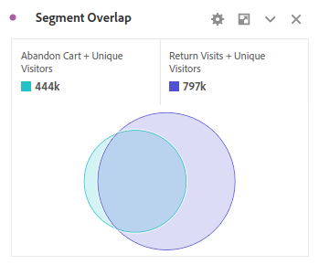
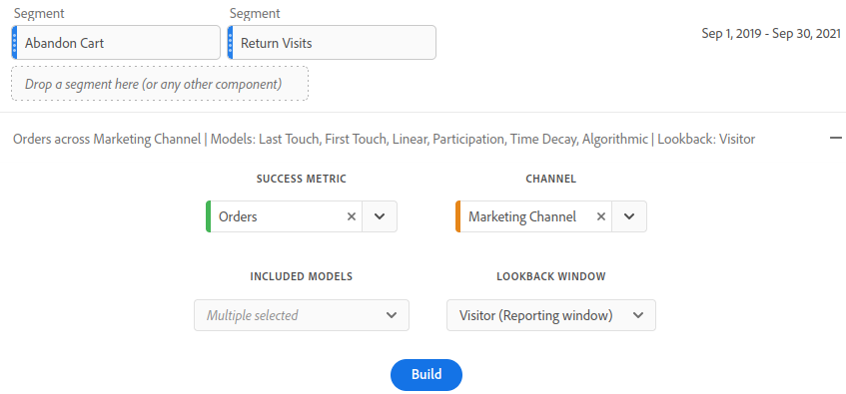
As per the question we started by looking at the segments ‘Abandon Cart’ and ‘Return Visits’, we used segment comparison.
Observation (4.1) :- From fig 4.1 which is one of the result of segment comparison.
We were convinced to use these segments for further analysis. Because there is a good no. of intersection between them, which might disclose more information as we dwell deep.
Fig : 4.1 Segment Overlap of Abandon Cart and Return Visits.
Fig : 4.2 Parameters used for the Attribution.
After being sure about the segments we
need.
We move to the next part for the question .i.e from which marketing channel does the customers come and place orders.
We decided to use Attribution with “Orders” and “Marketing channel” for this and interestingly we got good insights to drive our analysis further.

Slide 26
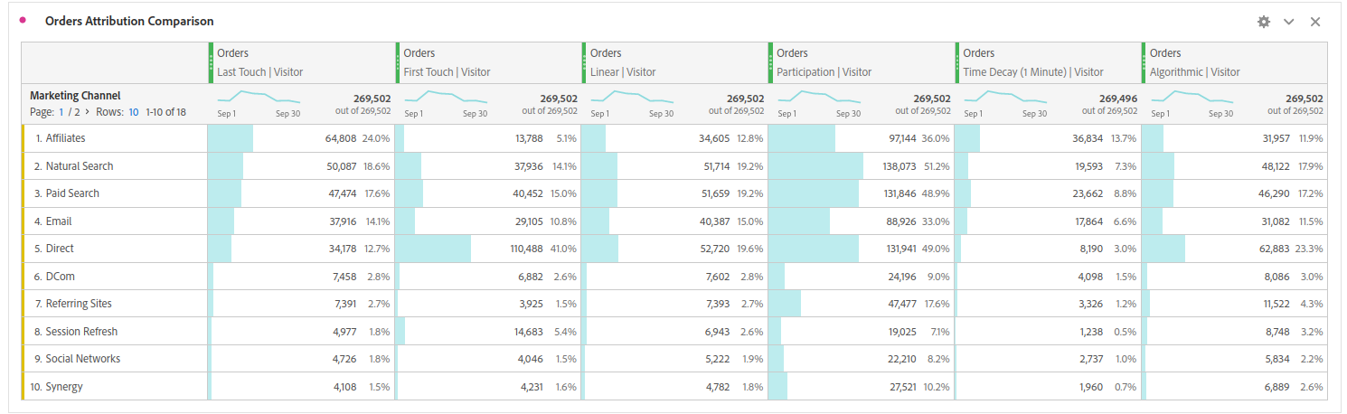
Fig : 4.3 Orders Attribution Comparison with Marketing Channel
Observation (4.2) :- From fig 4.3 which is one of the result of Attribution.
Orders Last Touch | Visitor : Marketing channel viewed by visitor just before placing the order.
Affiliate Marketing was the most effective one.
Orders First Touch | Visitor : Marketing channel that brought the visitor at first place to the Disney web.
Direct Channel was high as most of the visitors come to site voluntarily.
Orders Participations | Visitor : Marketing channels viewed by a visitor throughout their journey of placing order.
Natural Search, Paid Search and Direct Channels were most viewed by the visitors.

Slide 27
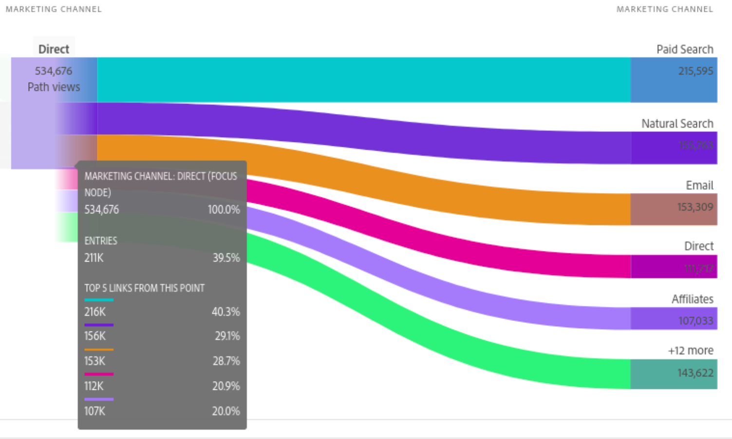
Fig : 4.4 Marketing Channel Flow as per Orders
Observation (4.3) :- From fig 4.4 which is one of the result of Attribution.
Among all the Marketing Channels “Paid Searches” gets the most return view to Disney Web.
Similarly “Affiliates” and “Emails” Marketing Channels also plays a good role in return visits.

Slide 28
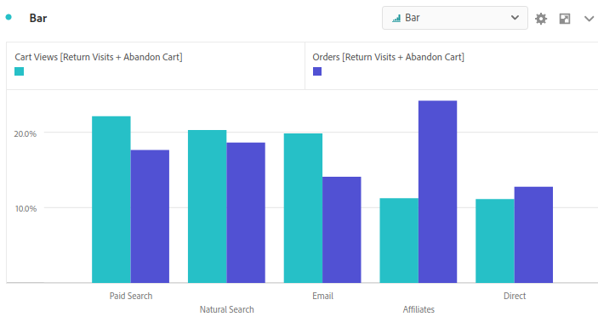
Fig : 4.5 Bar Graph on Marketing Channels VS Cart Views and Orders
Observation (4.4) :- From fig 4.5.
Even though the Marketing channels like “Paid Search” , “Natural Search” and “Emails” were successful in getting the customer to revisit and view there Abandoned Carts and place orders.
Affiliate Marketing channel gives the most positive results as it also place role in generating revenue but increasing orders.
According to Revenue generation Affiliate marketing channel was great performer.

Slide 29
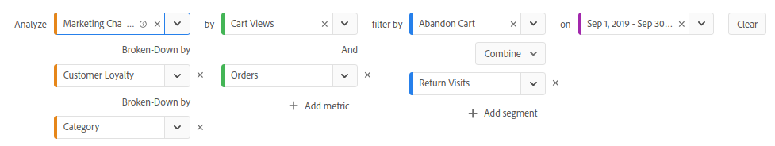
Fig : 4.6 Quick Insights using Above Parameters
Observation (4.5) :- From fig 4.6 If you visit the above quick insight it will be for clear.
The above insight gives the breakdown of Marketing channels , customer loyalty, and category of product the return visitor views.
One insight is that “Affiliate” Channels is most effective in “loyal customers” and the product category the view most and buy are “Accessories”
And we also get to know that “Accessories” are mostly promoted through “Affiliate”.

Slide 30
Inferences and conclusions if any
Affiliate Channel is best, for revenue increase on abandoned carts.
Affiliate Channel was not known to many visitors.
Most of the abandoned carts have “Accessories”.
1
Advice to Disney
Try to make visitor more aware about “Affiliate Marketing”.
Disney can think of applying techniques such as incentives and discounts on peer-to-peer recommendation which will incite more customers to not abandon their carts, which will help in recovering these carts successfully.

